Slide 1

Notes:
Slide 1: Title

Slide 2
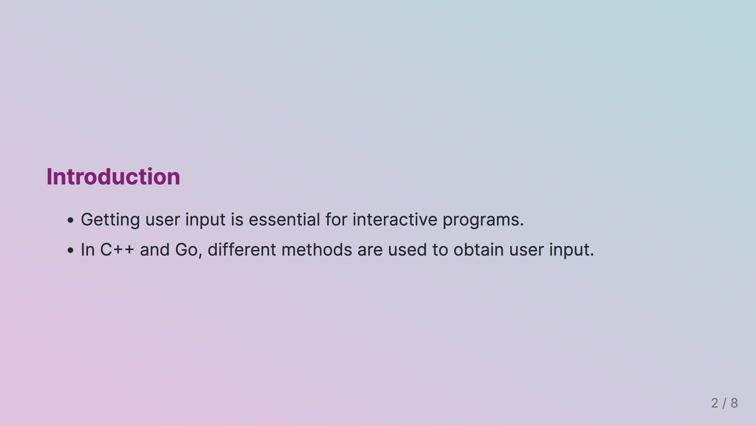
Notes:
Slide 2: Introduction

Slide 3
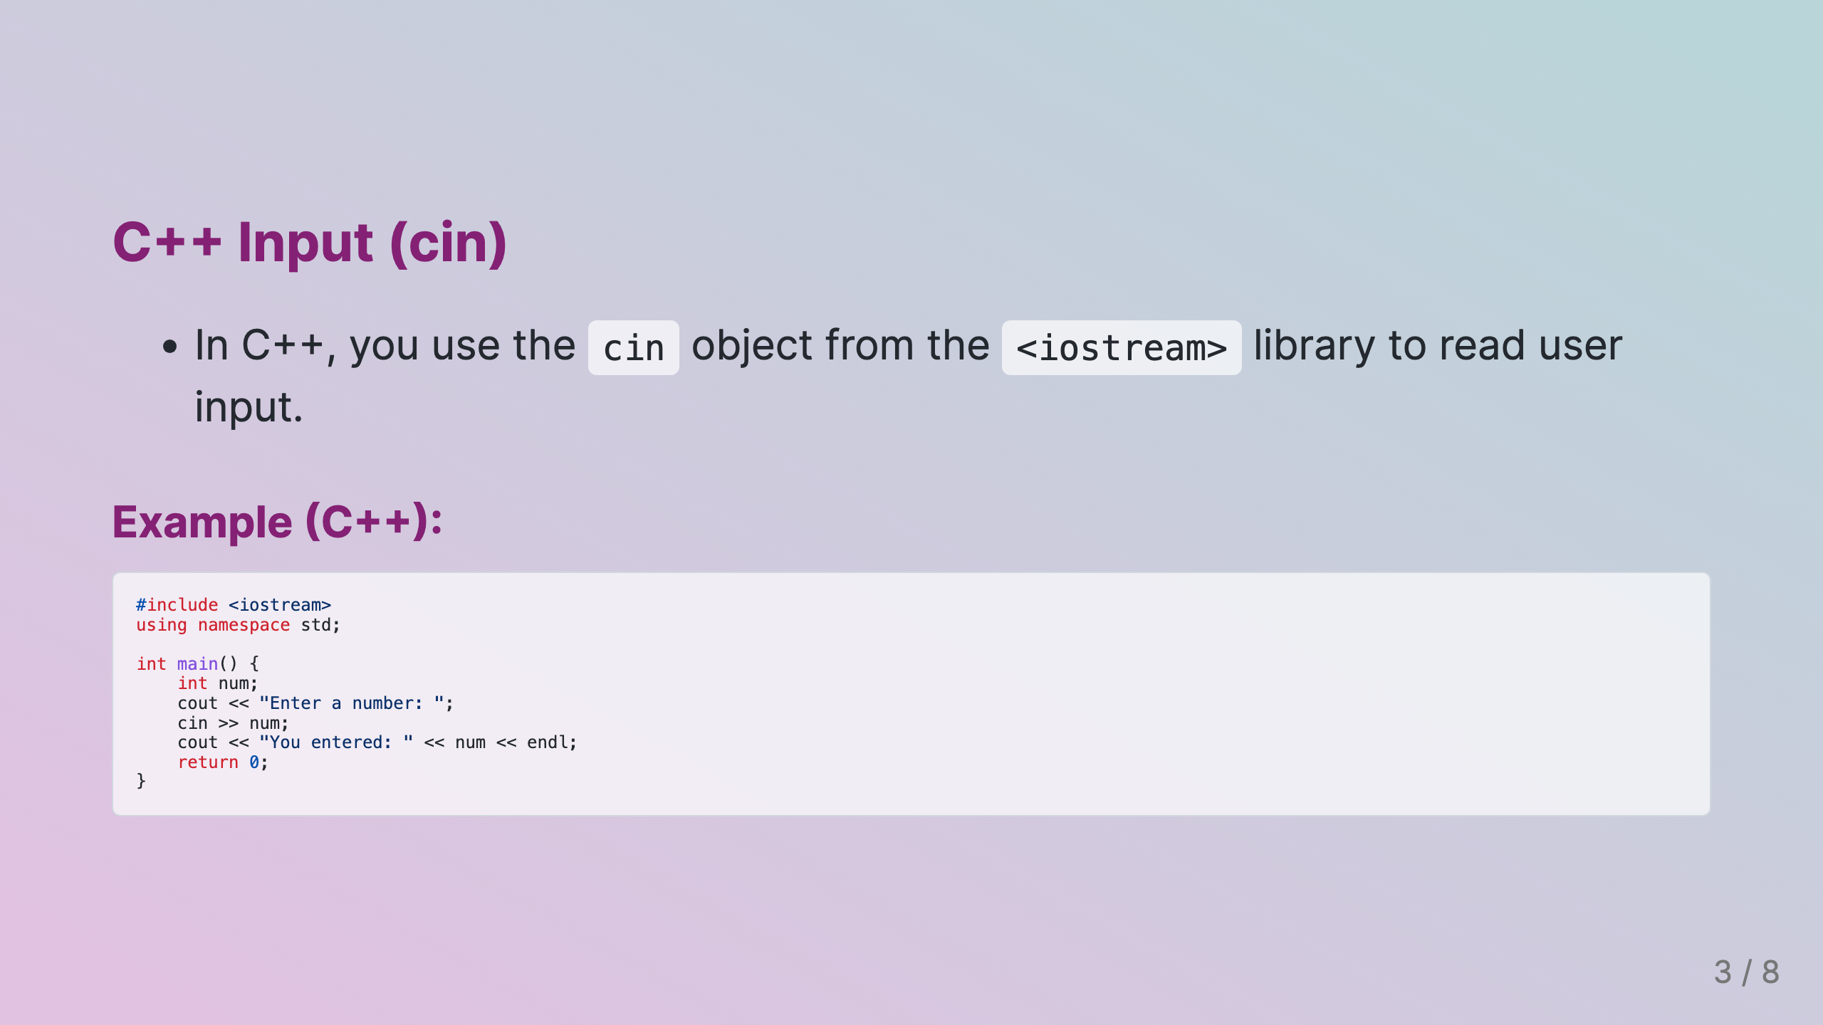
Notes:
Slide 3: C++ Input (cin)

Slide 4
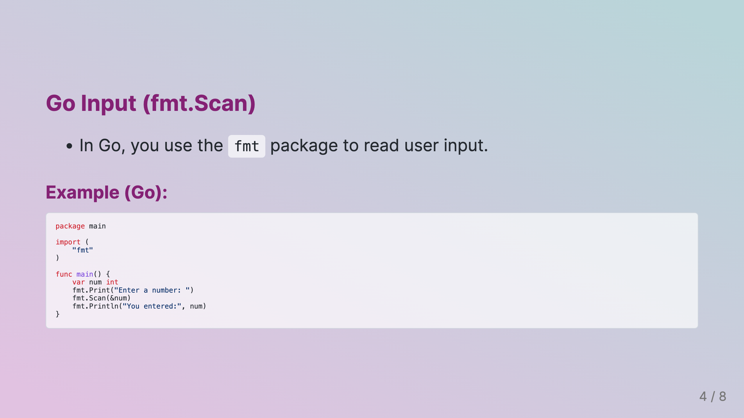
Notes:
Slide 4: Go Input (fmt.Scan)

Slide 5
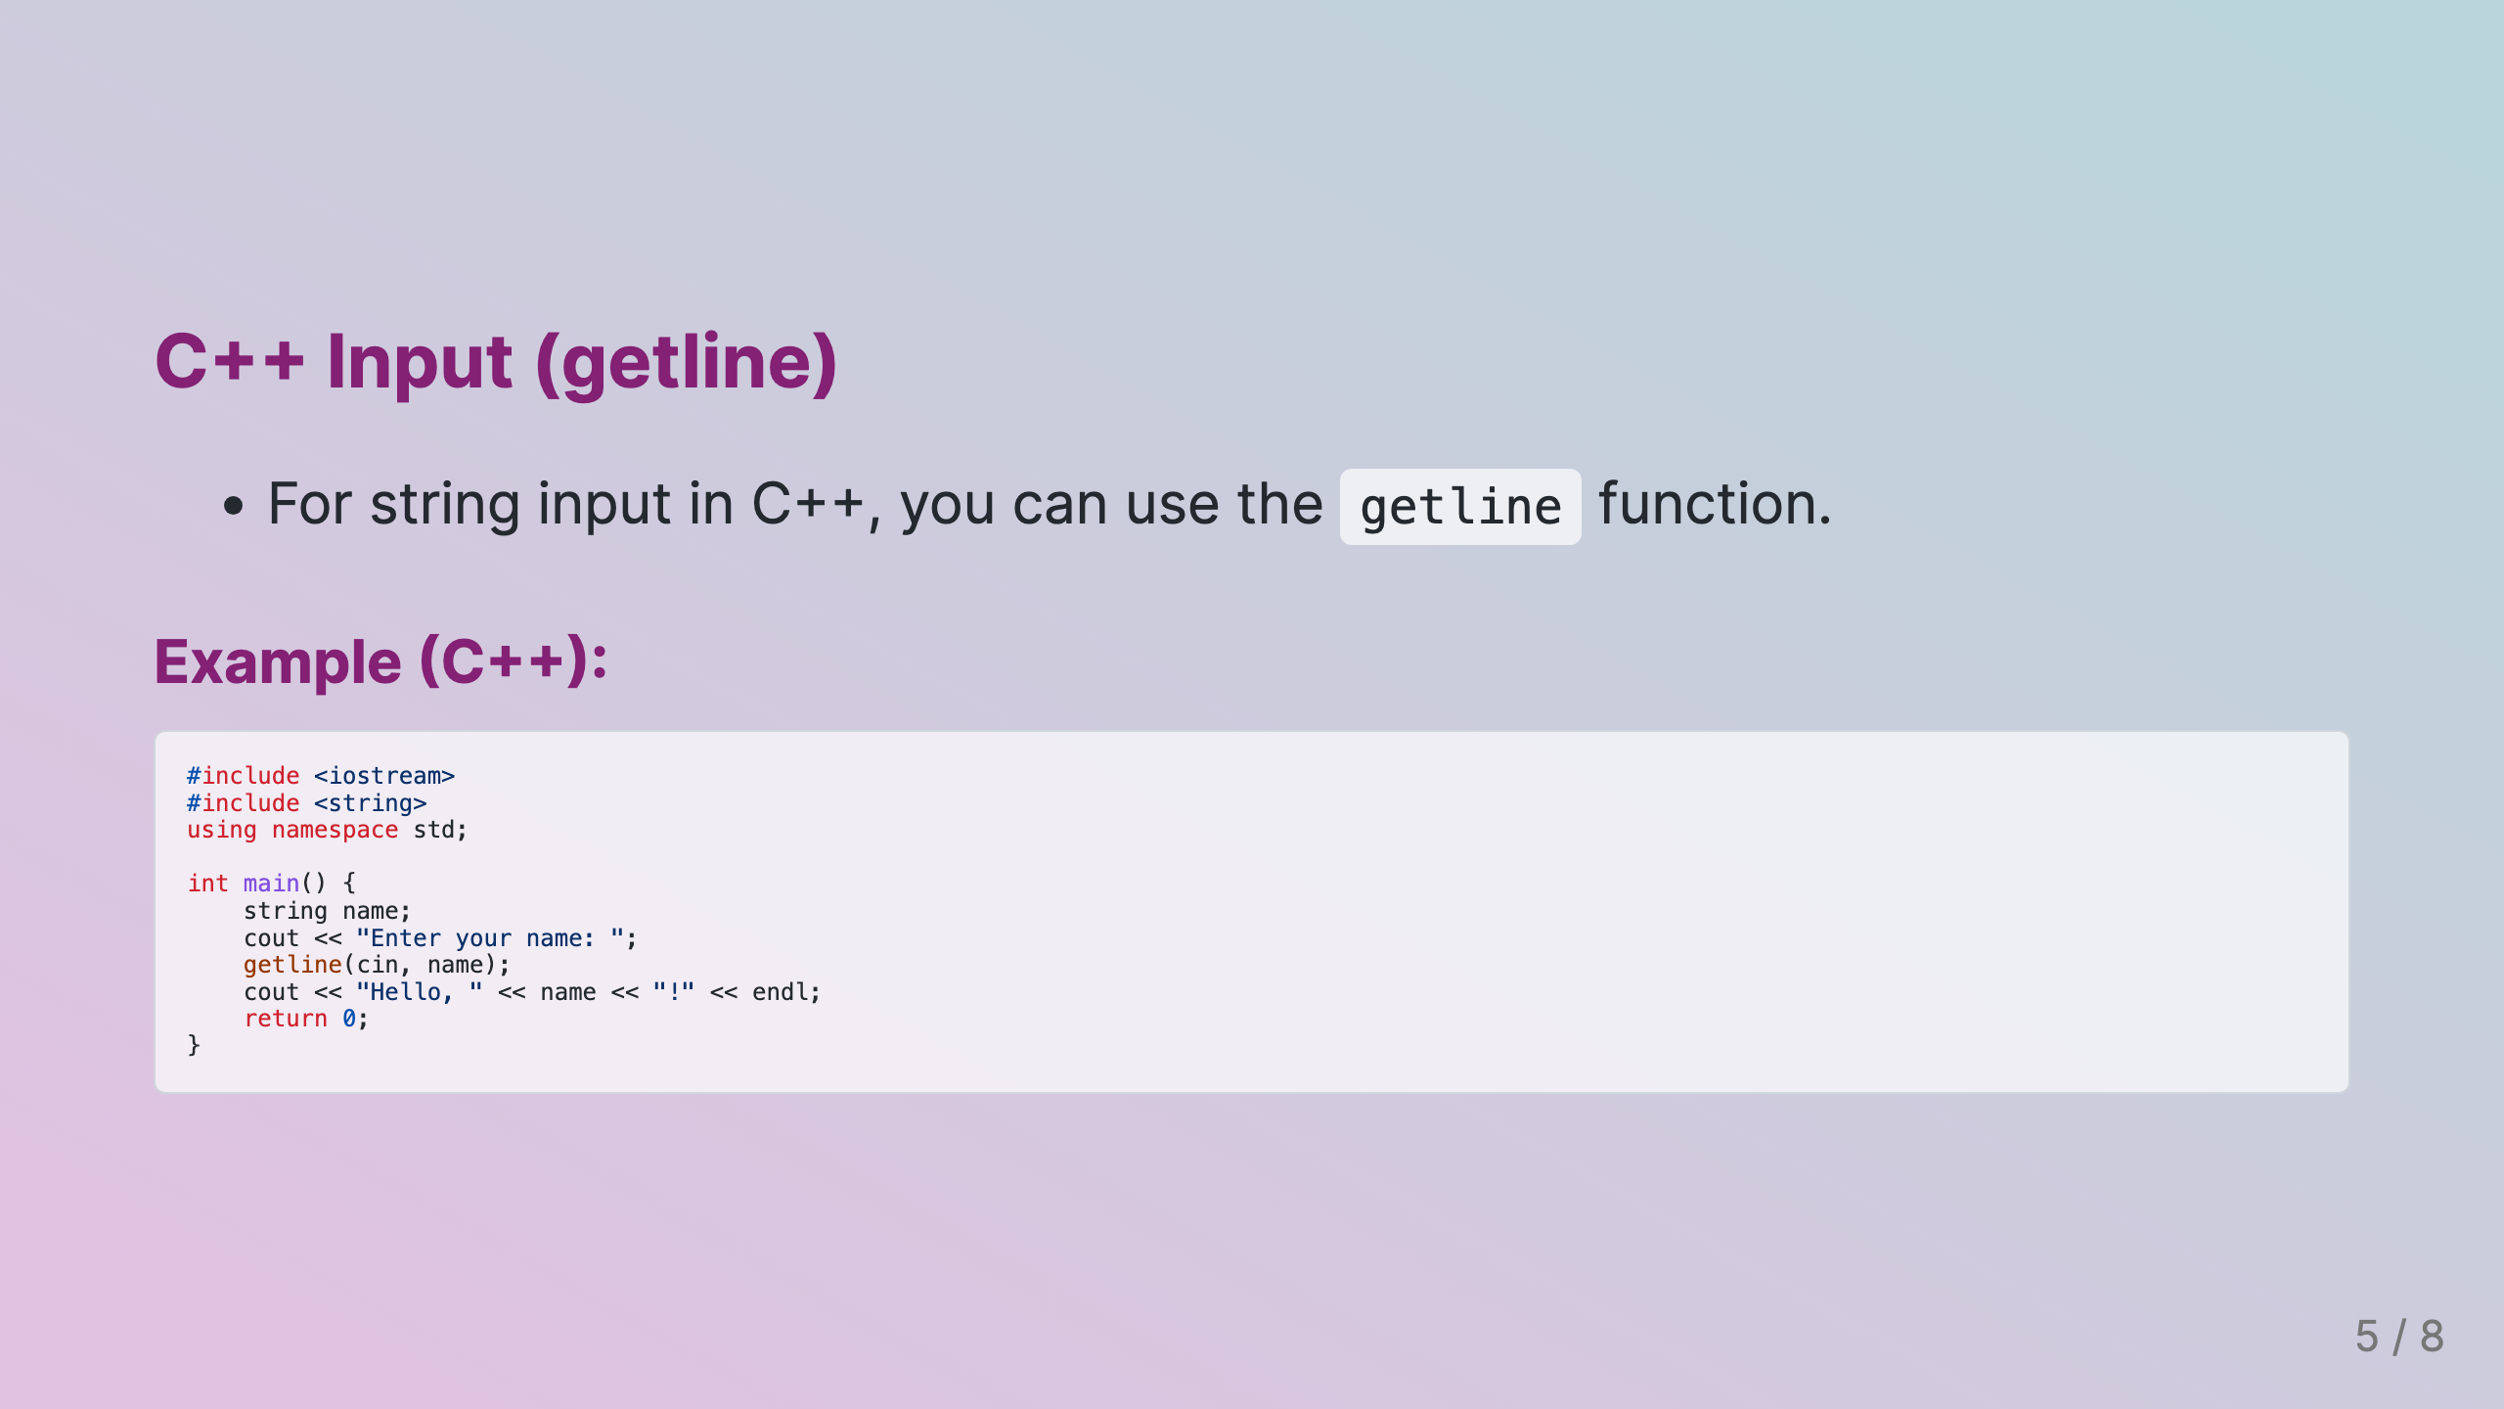
Notes:
Slide 5: C++ Input (getline)

Slide 6
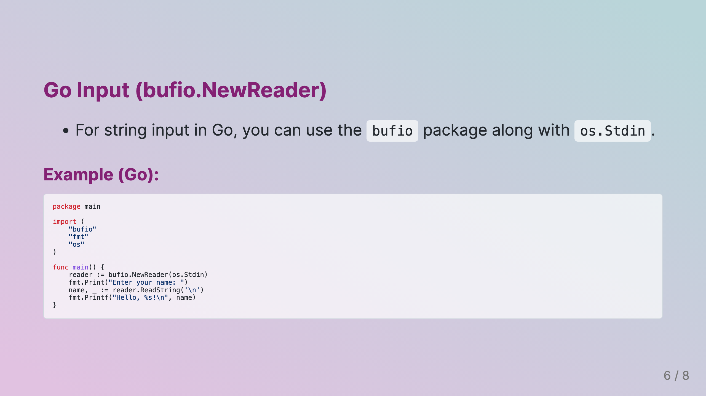
Notes:
Slide 6: Go Input (bufio.NewReader)

Slide 7
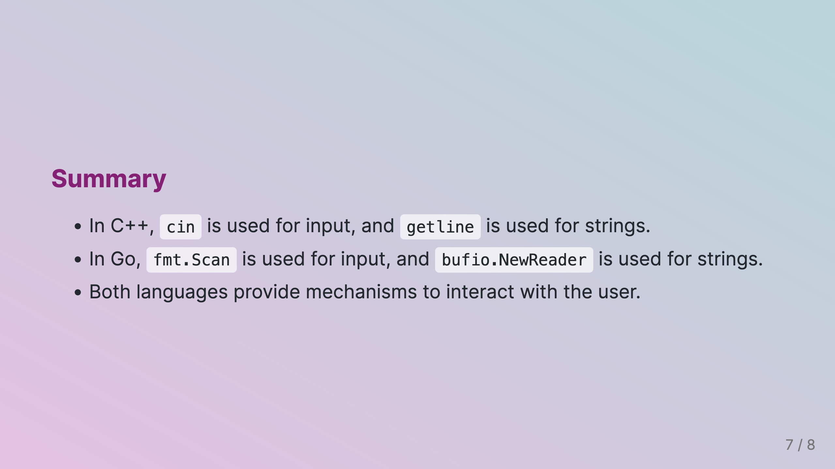
Notes:
Slide 7: Summary

Slide 8
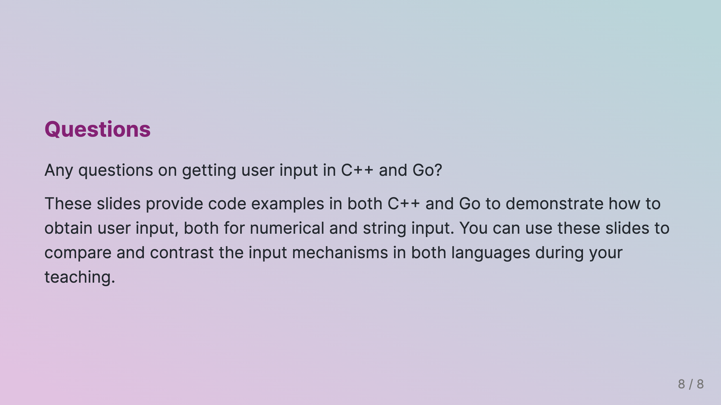
Notes:
Slide 8: Questions

